Slide 1
Objectives
  Language Fundamentals & Operators
After completing this chapter you will be able to,
  Identify Java Keywords
  Use Primitive Data Types
  Define, declare & initialize variables in Java.
  Identify Java Literals.
  Convert & Cast Primitives.
  Use Operators in Java

Slide 2
Java Keywords
What are Java Keywords?
  Keywords are reserved identifiers that are predefined in java language.
  Keywords cannot be used as names for variables, methods and classes.
Few Points on Java Keywords
  Keywords use letters only, they do not use special characters (such as $, _, etc.) or digits.
  All keywords are in lowercase letters and incorrect usage results in compilation errors.

Slide 3
Java Keywords Examples
abstract | default | implements | protected | throw
assert | do | import | public | throws
boolean | double | instanceof | return | transient
break | else | int | short | try
byte | extends | interface | static | void
case | final | long | strictfp | volatile
catch | finally | native | super | while
char | float | new | switch | null
class | for | package | synchronized | true
continue | if | private | this | false

Slide 4
Primitive Data Types
Java, like other programming languages such as C and C++, supports basic built-in data types, which are also called primitive data types.
There are eight primitive data types in Java they are,
Data Type | Size In Bits | Range | Default Value
boolean | 1 | true or false | false
byte | 8 | –2⁷ to 2⁷ – 1 | 0
short | 16 | –2¹⁵ to 2¹⁵ – 1 | 0
int | 32 | –2³¹ to 2³¹ – 1 | 0
long | 64 | –2⁶³ to 2⁶³ – 1 | 0L
float | 32 | –2³¹ to 2³¹ – 1 | 0.0f
double | 64 | –2⁶³ to 2⁶³ – 1 | 0.0d
char | 16 | 0 to 2¹⁵ – 1 | ‘\u0000’

Slide 5

Variables in Java
Dictionary Definition of Variables:
A quantity that can assume any of a set of values.
Something that is likely to vary; something that is subject to variation.
Variable analogy:
  The box is used as a container to hold white papers.
What is a Java variable?
  Similar to the box, Java variables are the basic unit of storage in a Java program. It is used to store the state of objects.

Slide 6
How are variables declared?
  Variables declaration:
  <data type> <name> [=initial value];
  Where,
    Data Type – Indicates the type of value that variable can hold.
    Name – Name by which the variable is identified.
  Values enclosed in <> are mandatory attributes
  Values enclosed in [ ] are optional attributes
  Example:
  int salary; // Declared a variable salary with data type int.
  (or)
  int salary =10000; // Salary declared as int with initial value 10000

Slide 7
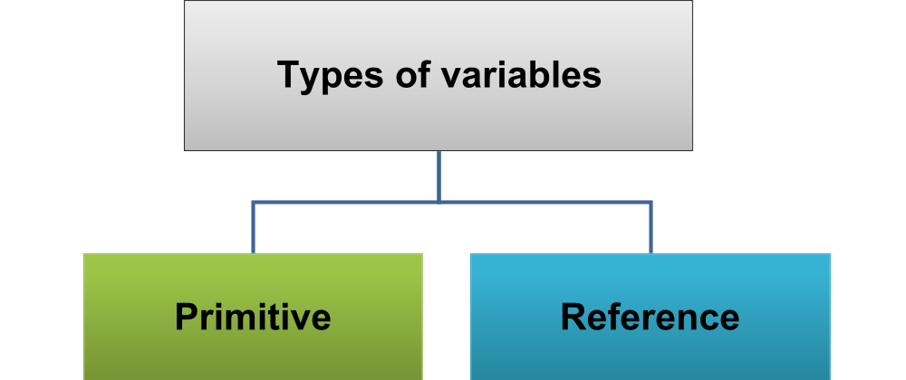
Types of variables in Java
Variables declared with object, this points to a location in memory where actual data is present
Variables declared with primitive data type such as int or long
Example: int tax;
Example: Employee emp;
NOTE: A primitive variable holds the value of the data item, while a reference variable holds the memory address where the object values are stored.

Slide 8
Variables initialization in Java
Initializing Variables:
  The process of assigning an initial value to a variable is called initialization.
  Syntax:
<data Type> <variableName> = <initialValue> ;
Example:
int tax = 5;
The above statement declares a variable named tax of data type int and assigns an initial value of 5 that can later be changed.

Slide 9
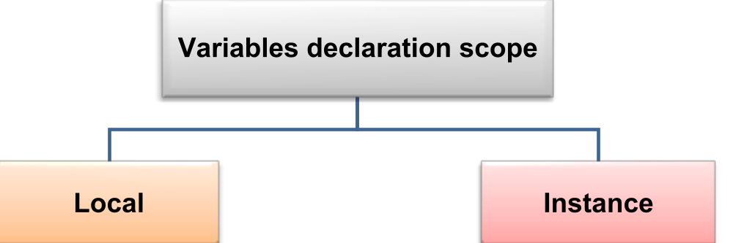
Variables declaration scope.
Variables declared inside a method.
Can be accessed only inside the method in which they are declared.
They lose their values stored when the method execution completes.
Variables declared inside a class and not inside any method.
This variable can be accessed by all the methods of that class.
This variable can also be accessed by other classes based on access modifiers.
You will learn more about variable scope and accessibility in the Access modifier session.

Slide 10
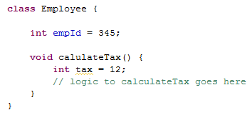
Variables Declaration example
Example:
Instance Variable – Declared inside the body of the class.
Local Variable – Declared inside the body of the method.

Slide 11
Variables Naming Rules
Variable Naming Rules:
  The first character of a variable must be a letter, a dollar sign ($), or an underscore (_).
    The convention is to however begin your variables with a letter.
  A character other than the first character in an identifier may be a letter, a dollar sign, an underscore, or a digit.
    Example: age, $count, _count.
  None of the Java language keywords (or reserved words) can be used as identifiers.

Slide 12
Variables Naming Rules (Cont)
Variable Naming Rules:
  If the variable name has only one word, then spell that word in all lowercase letters. If it consists of more than one word, then capitalize the first letter of each subsequent word.
  Example: employeeName, employeeAge
  Avoid abbreviations, the variable name should be meaningful.
  Don’t: empSal, empAdd.
  Do: empSalary, empAddress.

Slide 13
Java Literals
What is a literal?
A literal is a value assigned to a variable in a class.
Literals appears on the right hand side of the variable declaration.
Literals value can be assigned for any of the primitive data type.
  Example:
    int tax = 5 ;
    (or)
float salary =1000.0;
A literal is a value and not a variable
Where “5” and “1000.0” are int and float literals respectively.

Slide 14
Lend a Hand – Variables Declaration
Create a java class “Employee” with the following variables created,
Create a method named calulatePF() which will have a local float variable named “pfRate” with value as 10.5 and the following message should be printed.
“The PF Rate Of The Employee is <pfRate>”
3. Create a java class “MainProgram” add a main method which will
  Create a object instance of the Employee.
  Access the instance variables and display the default values of variable as follows .
  “The Id of the Employee is <empId> ”
  “The Salary of The Employee is <empSal> ”
  “The Percentage of Tax The Employee needs to Pay is <empTax>”
  “The Total Number of Working Days is <daysOfWork>”
  Invoke the calculatePF() method .
Variable Name | Data Type | Default value
empId | long | 345
empSalary | Double | 10,000
empTax | Float | 9.5
empDaysOfWork | Int | 24

Slide 15
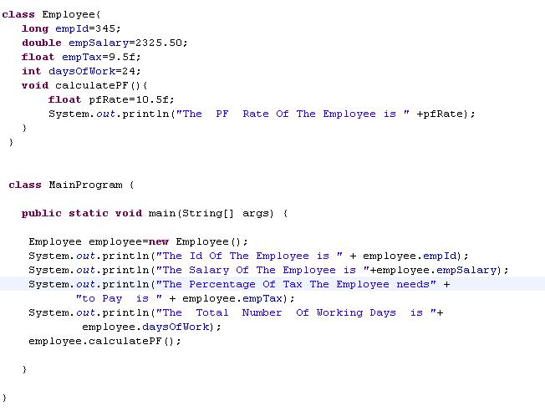
Lend a Hand – Solution

Slide 16

Casting Primitives
What is casting?
Casting is the process by which a liquid is poured into a mold and is allowed to solidify. In this process, it attains the shape of the mold
Similarly in Java, a value of one primitive type is assigned to a variable of another primitive type. This is called primitive type casting.
Example: A variable int is casted into float. Here float is the mold and int variable is casted as a float.
  Casting is done with any of the primitive data types
  Boolean type variable cannot be casted

Slide 17
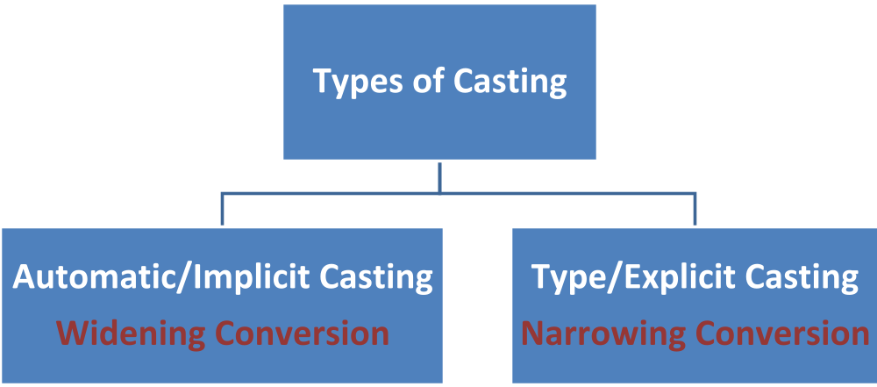
Types of primitive casting

Slide 18
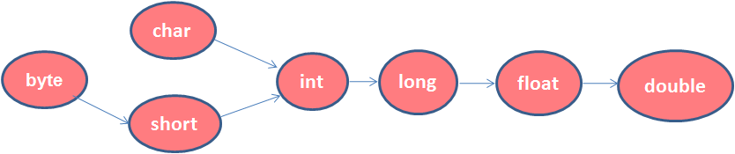
Automatic/Implicit Casting
Java will performs automatic conversion when:
  The two data types are compatible.
  The destination data type is larger than the source data type.
Example: An int value (source) to a long variable (destination).
    int mySal=500;
    long sal=mySal;
Destination(64 bits)
Source(32 bits)
Figure depicts the allowed conversions for primitive data types (arrows indicate paths of allowed conversion).
Example: int can be type casted to long. Long can be type casted to float. etc

Slide 19
Type/Explicit Casting
Explicit Casting will be done by the programmers when the following condition is met.
  The destination type is smaller than the source type.
Example:
double pf=12.67;
float myPf=pf; // compile-time error.
float myPf=(float) pf; // Explicit Casting.
A different type of conversion named “truncation” will occur when a floating-point value is assigned to an integer type.
Example: if the value 1.23 is assigned to an integer, the resulting value will be 1.The 0.23 will have been truncated.

Slide 20
Operators in Java
What is an operator?
Operators are special symbols that perform specific operation on one, two or more operands and return a result.
Example:
  Here,
    a and b are variables
    the data in a and b are operands
    ‘+’ is the operator
    c contains the result
  Navigate to the next slide for more explanation
a + b = c

Slide 21
Operators in Java
Operators operate on the data represented by a variable.
The data that is being operated on is called an operand.
Operators operate on their operands in a variety of ways
    Operators change the values of their operands.
    Operators can produce a new value without changing the values of the operands.
    Operators can compare the values of two operands.

Slide 22
Types of Operators in Java
Types of data operators based on the number of operands,
  Unary operators: Require only one operand.
  Example:
  ++ increments the value of its operand by 1.
  - - decrement the value of its operand by 1.
  Binary operators: Require two operands.
  Example:
  + adds the values of its two operands.
  Ternary operators: Operate on three operands(?).
  The ? operator consists of three operands and is used to evaluate boolean expressions. The goal of the operator is to decide which value should be assigned to the variable.
  Syntax:
  variable x = (expression) ? value if true : value if false

Slide 23
Example of Ternary Operator
class Test{
public static void main(String args[]){
int num1=10;
int num2;
num2 = (num1>5) ? 20: 30;
System.out.println( "Value of num2 is : " + num); }
}
In the above example since the num1 is greater than 5 the value 20 will be assigned to num2.
If num1 is < 5 the value 30 will be assigned to num2.

Slide 24
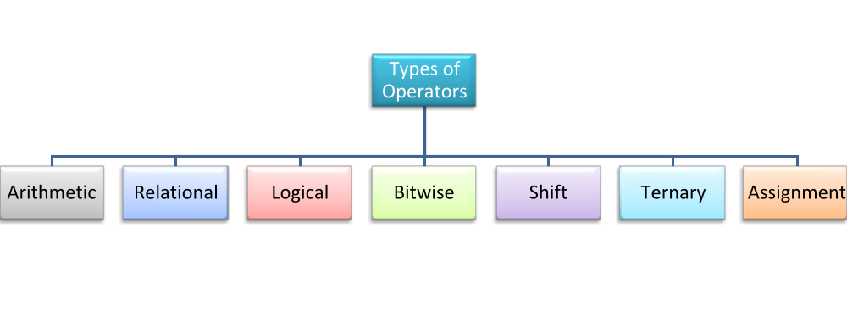
Types of operators
Types of Operators – Based on the Operation
You will learn more about operators in the next coming slides.

Slide 25
Arithmetic Operators
Arithmetic Operator:
  Arithmetic operators are used for mathematical calculations. The following table lists the arithmetic operators,
Operator | Value of a | Value of b | Usage | Value of c
+ | 6 | 5 | c=a+b | 11
- | 6 | 5 | c=a-b | 1
* | 6 | 5 | c=a* b | 30
/ | 6 | 5 | c=a/b | 1
% | 6 | 5 | c=a%b | 1

Slide 26
Unary Operators
Unary Arithmetic Operator:
The unary operators require only one operand. They perform various operations such as incrementing/decrementing a value by one, negating an expression, or inverting the value of a boolean.
Operator | Use | Description
- | int a =-b; | Negates the operand b and stores the value in a
++ | int b=a ++ | Increments the value of a by 1
-- | Int b=a -- | Decrements the value of a by 1

Slide 27
Unary Operators (cont)
Example of Increment & Decrement Operators:
Initial Value of x | Code Statement | Final Value of y | Final value of x
7 | y=++x; | 8 | 8
7 | y=x++; | 7 | 8
7 | y=--x; | 6 | 6
7 | y=x--; | 7 | 6

Slide 28
Relational Operators
Relational Operator:
A Relational operator, also called a comparison operator, compares the values of two operands and returns a boolean value, true or false.
Operater | Use | Description
> | op1>op2 | True if op1 is greater than op2, otherwise false
>= | op1>=op2 | True if op1 is greater than or equal to op2, else false
< | op1 < op2 | True if op1 is less than op2, otherwise false
<= | op1 <=op2 | True if op1 is less than or equal to op2, otherwise false
== | op1 == op2 | True if op1 and op2 are equal, otherwise false
!= | op != op2 | True if op1 and op2 are not equal, otherwise false

Slide 29
Lend a Hand – Operators
Create a java class “Calculator” with two instance variable int num1 and num2.
Create three methods “addition“,“subtraction” and ”printSmaller” which will add ,subtract and print the smallest of two numbers respectively. The methods should display the results as follows,
  Addition:“The Sum of the Two numbers <num1> and <num2> is <result>”
  Subtraction:“The Subtracted Result of the two numbers <num1> and <num2> is <result>”
  Print Smaller:“The Smallest of the Two numbers <num1> and <num2> is <result>”
Create a java class “MainProgram” add a main method which will
  Create a object instance of the Calculator .
  Set the value of num1 and num 2 as 12 and 8.
  Invoke the methods “addition”,“subtraction” and “printSmaller “.
The message needs to be displayed in the console.

Slide 30
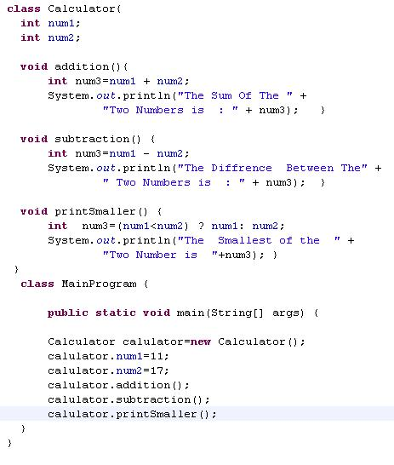
Lend a Hand - Solution

Slide 31
Logical Operators
Logical Operator:
Logical operators are used to evaluate one or more conditions and return a true or false value based on conditions result.
Operator | Operator Type | Use | Description
&& | Binary | op1 &&op2 | True if both the operands are true, otherwise false.
|| | Binary | op1 ||op2 | True if any one of the operand is true , otherwise false.
! | Unary | ! op1 | True if operand is false and vice versa

Slide 32
Assignment Operators
Assignment Operators:
  An assignment operator is used to set (or reset) the value of a variable
Operator | Use | Description
+= | op1 +=op2 | Equivalent to op1=op1+op2
-= | op1-=op2 | Equivalent to op1=op1-op2
*= | op1*=op2 | Equivalent to op1=op1 * op2
/= | op1 /=op2 | Equivalent to op1=op1/op2
%= | op1%=op2 | Equivalent to op1=op1%op2

Slide 33
Operator Precedence
If in a expression there are more than one operators the order in which they are evaluated would be based on the operator precedence.
Precedence | Operator
1 | ( ),[ ]
2 | ++,--
3 | *,/,%,+,-
4 | <.<=,>,>=
5 | ==,!=
6 | &&,||

Slide 34
Operator Precedence Example
Let us analyze some examples to understand the precedence of operators
Example 1:
result = (num1*num2) + num3 / num4;
Here is the order on how the above expression is processed
  num1 * num2
  num3 / num4
  Final Result = result of step 1 + result of Step 2

Slide 35
Operator Precedence Example
Example 2:
result = num1 > num2 && num3 <= num4 || num5 != num6;
Here is order on how the above expression is processed
  num1 > num2
  num3 <= num4
  num5 != num6
  Result of Step 1 && Result of Step 2
  Final Result = result of Step 4 || result of Step 3

